Slide 1


Programming with Python
and Bananas
Ron Greeff

Slide 2


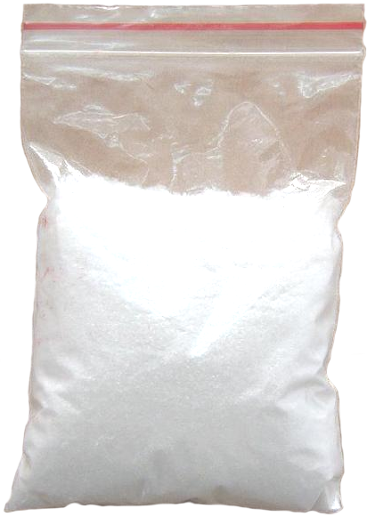
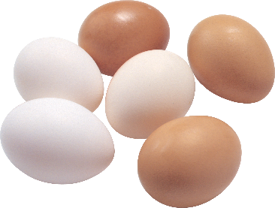



Variables
used to store information to be referenced and used by programs
Bananas
Butter
Flour
Eggs

Slide 3
Variables
declaration
name
data
my_variable = <data object>

Slide 4

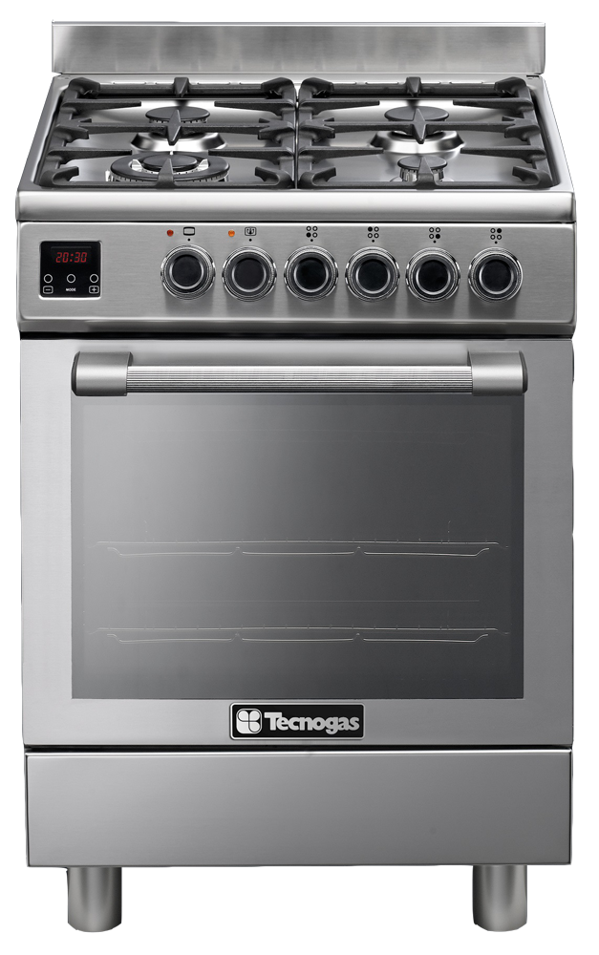



Functions
a named section of a program that performs a specific task
Oven
def_time = 20mins
def_temp = 200°C
Boil
Timer
Bake
Masher
Whisk
Sieve

Slide 5
Functions
a named section of a program that performs a specific task
declaration
name
parameters
def my_function(input_a, input_b):
output = input_a + input_b
return output
process
output

Slide 6

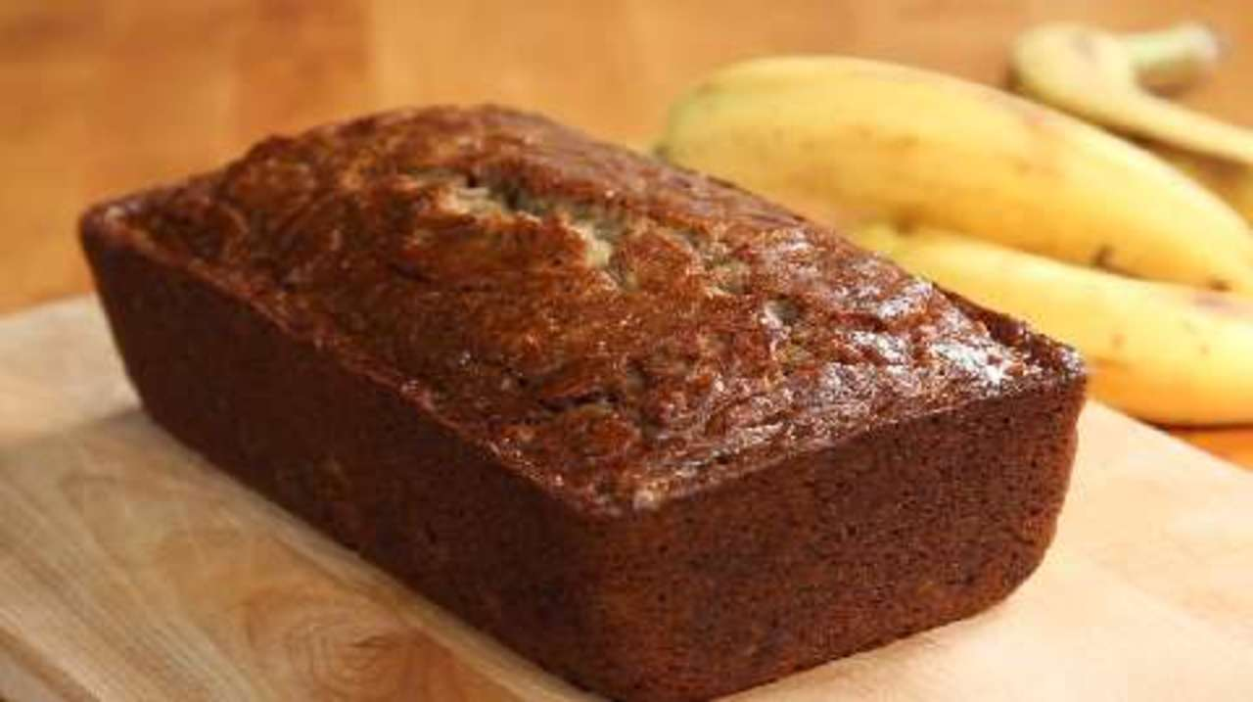
Program
A computer program is a collection of instructions that performs a specific task when executed by a computer.

Slide 7

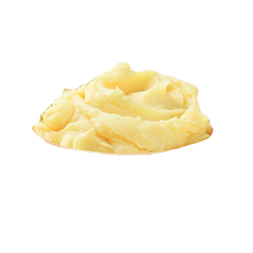


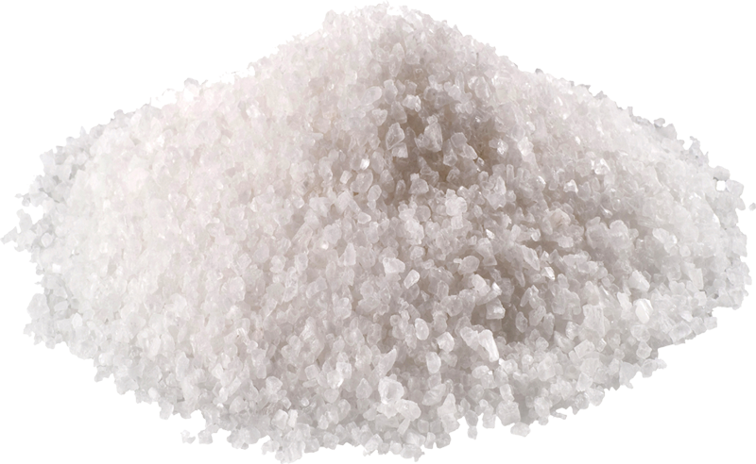









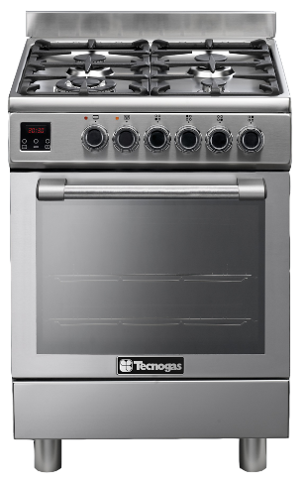
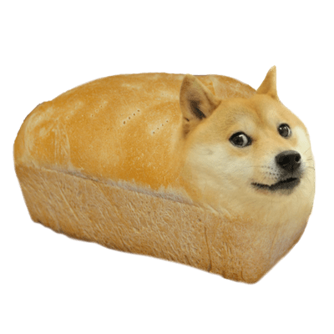








from kitchen import oven
from utensils import masher, whisk, wood_spoon
def soften_bananas(bananas):
banana_mash = masher.mash(bananas)
return banana_mash
def melt_butter(butter):
return oven.hob(butter)
def sieve_flour(flour):
return sieve.sieve(flour)
def mix(banana_mash, melted_butter, fine_flour, eggs):
return wood_spoon.mix(banana_mash,
melted_butter, fine_flour)
banana_bread = oven.bake(banana_dough, 40)

Slide 8

Any questions?

Slide 9
Rule 5. Data dominates. If you've chosen the right data structures and organized things well, the algorithms will almost always be self-evident. Data structures, not algorithms, are central to programming.
- Rob Pike's 5 Rules of Programming

Slide 10
Common data types
Data type
Example
Boolean
Integer
Float
String
List
Dictionary
Tuple
TRUE, FALSE
0, 99, 100, …
0.1, 1.00, 99.999999, …
“Banana”
[ TRUE, 99, 0.1, “Banana”, [“nested”] ]
{ “key”: “value”, “number”: 0, “n”: [] }
( TRUE, 99, 0.1, “Banana”, [“nested”] )

Slide 11
String
Characteristics
Useful in-built functions (methods)
Strings are denoted by quotes
“this is a string”
“anything”
“21”
“ “
capitalize()
title()
strip()
split()
startswith()
endswith()
replace()

Slide 12
List
Characteristics
Useful in-built functions (methods)
Lists are one of several collections
[“string”, 21, True]
Lists are ordered
Lists items are accessed by an index
my_list = [‘a’, ‘b’, ‘c’]
my_list[0]
my_list[0:1]
my_list[:-1]
append()
insert()
remove()
join()
reverse()
pop()

Slide 13
Conditionals and Operators
Conditionals
Operators
if <condition>:
do this
elif <a different condition>:
do that
else:
do something else
in
not in
is
is not
x in y – True if x is a member of sequence y
True if x not in sequence y
x is y – True if x is equal to y
True if x not equal to y

Slide 14
Exercise
top_100_names = ["OLIVIA", "RUBY", "EMILY", "GRACE", "JESSICA", "CHLOE", "SOPHIE", "LILY", "AMELIA", "EVIE", "MIA", "ELLA", "CHARLOTTE", "LUCY", "MEGAN", "ELLIE", "ISABELLE", "ISABELLA", "HANNAH", "KATIE", "AVA", "HOLLY", "SUMMER", "MILLIE", "DAISY", "PHOEBE", "FREYA", "ABIGAIL", "POPPY", "ERIN", "EMMA", "MOLLY", "IMOGEN", "AMY", "JASMINE", "ISLA", "SCARLETT", "LEAH", "SOPHIA", "ELIZABETH", "EVA", "BROOKE", "MATILDA", "CAITLIN", "KEIRA", "ALICE", "LOLA", "LILLY", "AMBER", "ISABEL", "LAUREN", "GEORGIA", "GRACIE", "ELEANOR", "BETHANY", "MADISON", "AMELIE", "ISOBEL", "PAIGE", "LACEY", "SIENNA", "LIBBY", "MAISIE", "ANNA", "REBECCA", "ROSIE", "TIA", "LAYLA", "MAYA", "NIAMH", "ZARA", "SARAH", "LEXI", "MADDISON", "ALISHA", "SOFIA", "SKYE", "NICOLE", "LEXIE", "FAITH", "MARTHA", "HARRIET", "ZOE", "EVE", "JULIA", "AIMEE", "HOLLIE", "LYDIA", "EVELYN", "ALEXANDRA", "MARIA", "FRANCESCA", "TILLY", "FLORENCE", "ALICIA", "ABBIE", "EMILIA", "COURTNEY", "MARYAM", "ESME"]
my_name = ''
def my_function(my_name, list_of_names):
if my_name in list_of_names:
print(my_name + ' is in the list!')
else:
print(my_name + ' is not in the list')
if <condition>:
do this
else:
do that
<condition>
True if x in sequence y
my_function(my_name, top_100_names)

Slide 15
For loops
Using loops in computer programming allows us to automate and repeat similar tasks multiple times.
for <iterating variable> in <iterable sequence>:
<do something cool>
for name in ["OLIVIA", "RUBY", "EMILY",…]:
do something with name

Slide 16
Exercise
top_100_names = ["OLIVIA", "RUBY", "EMILY", "GRACE", "JESSICA", "CHLOE", "SOPHIE", "LILY", "AMELIA", "EVIE", "MIA", "ELLA", "CHARLOTTE", "LUCY", "MEGAN", "ELLIE", "ISABELLE", "ISABELLA", "HANNAH", "KATIE", "AVA", "HOLLY", "SUMMER", "MILLIE", "DAISY", "PHOEBE", "FREYA", "ABIGAIL", "POPPY", "ERIN", "EMMA", "MOLLY", "IMOGEN", "AMY", "JASMINE", "ISLA", "SCARLETT", "LEAH", "SOPHIA", "ELIZABETH", "EVA", "BROOKE", "MATILDA", "CAITLIN", "KEIRA", "ALICE", "LOLA", "LILLY", "AMBER", "ISABEL", "LAUREN", "GEORGIA", "GRACIE", "ELEANOR", "BETHANY", "MADISON", "AMELIE", "ISOBEL", "PAIGE", "LACEY", "SIENNA", "LIBBY", "MAISIE", "ANNA", "REBECCA", "ROSIE", "TIA", "LAYLA", "MAYA", "NIAMH", "ZARA", "SARAH", "LEXI", "MADDISON", "ALISHA", "SOFIA", "SKYE", "NICOLE", "LEXIE", "FAITH", "MARTHA", "HARRIET", "ZOE", "EVE", "JULIA", "AIMEE", "HOLLIE", "LYDIA", "EVELYN", "ALEXANDRA", "MARIA", "FRANCESCA", "TILLY", "FLORENCE", "ALICIA", "ABBIE", "EMILIA", "COURTNEY", "MARYAM", "ESME"]
my_name = ''
def my_function(my_name, list_of_names):
if my_name in list_of_names:
print(my_name + ' is in the list!')
else:
print(my_name + ' is not in the list')
lower_cased_names = []
for upper_case_name in top_100_names:
lower_cased_names.append(lower_cased_names.title())
lower_cased_names = [name.title() for name in top_100_names]
my_function(my_name, top_100_names)

